Slide 1
Bright TV Audience Insights
Business Insights for the CEO
Prepared by: Brandon Mloyi
Date: 31/09/2025

Slide 2
Introduction
Purpose: To understand Bright TV’s audience profile and viewing behavior.
Data: User profiles + viewership logs (SQL query with buckets).
Goal: Provide insights to increase viewership & advertising revenue.

Slide 3
Methodology
Data cleaned and merged in SQL (Databricks).
Created buckets for Age, Time-of-Day, and Engagement Duration.
Analysis done via Pivot Tables and Charts (Google Looker Studio / Sheets).
Insights interpreted into business recommendations.

Slide 4
Key KPIs
Total Users: 5375
Average Viewing Duration: 1758413348.31
Peak Time-of-Day: 3807(afternoon)
Most Popular Channel: 1,234

Slide 5
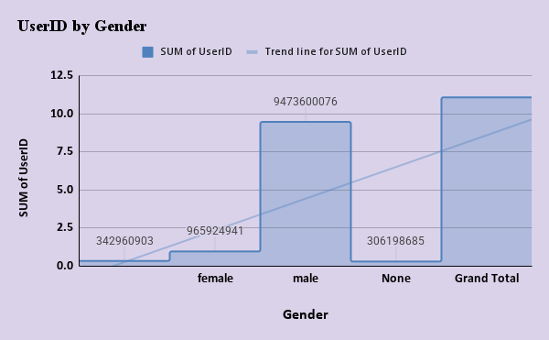
Audience by Gender
Majority female audience.
Male viewers form a strong secondary group.
Balanced gender split = opportunity for diverse programming.

Slide 6
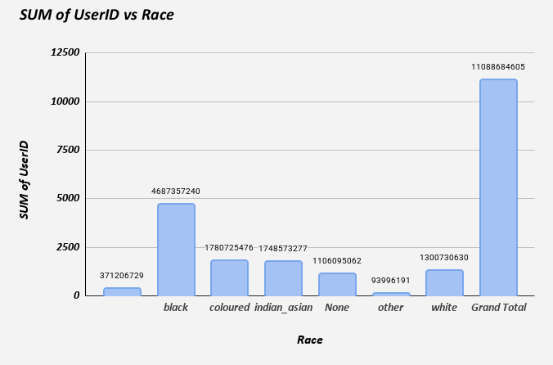
Audience by Race
Representation across multiple groups.
Largest audience segment: black.
Tailoring content for key groups can expand reach.

Slide 7
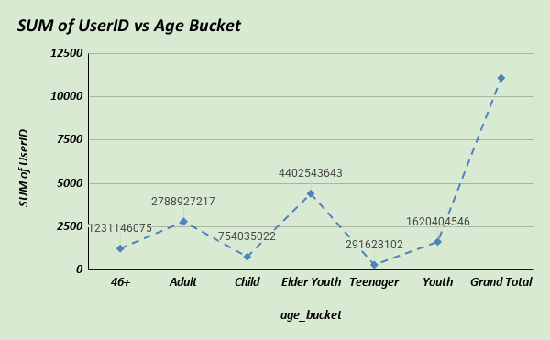
Audience by Age Bucket
Strong viewership among Youth (18-25) and Elder Youth(26-35).
Adults (36–45) provide stability.
Children/Teens = small segment, but potential future market.

Slide 8
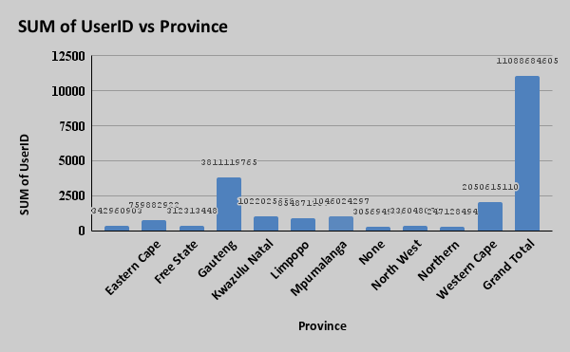
Audience by Province
Highest concentration in Gauteng.
Secondary clusters in Western Cape.
Regional campaigns should focus on top 3 provinces.

Slide 9
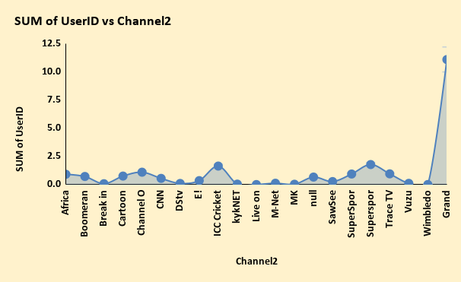
Channel Popularity
SuperSport Live Events = clear leader.
ICC Cricket World Cup 2013 and Supersport Blitz strong but niche.
Low-performing channels may need repositioning or targeted promotion.

Slide 10
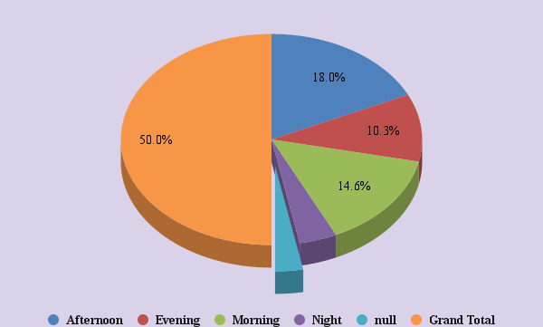
Time-of-Day Viewing
Evenings = peak viewership.
Afternoons moderate, strong for younger audiences.
Mornings/Nights weak = not ideal for prime ads.

Slide 11
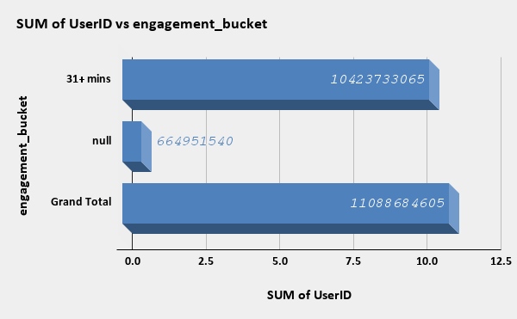
Engagement Duration
Most Viewers stay 6-15 minutes.
Loyal core stays 30+ minutes.
Strategy: extend average watch time with engaging time formats.

Slide 12
Gender × Channel
From our dataset,most channels are dominated by male viewers, particularly SuperSport and ICC Cricket.
Female representation is much smaller across all channels, with no channel showing clear female dominance.
This suggest Bright TV’s programming is currently skewed towards a male audience - an opportunity to balance the portfolio by investing in content that appeals more to women.

Slide 13
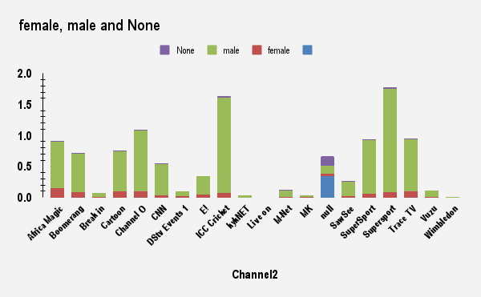
This is the chart showing analysis on gender, channel viewership

Slide 14
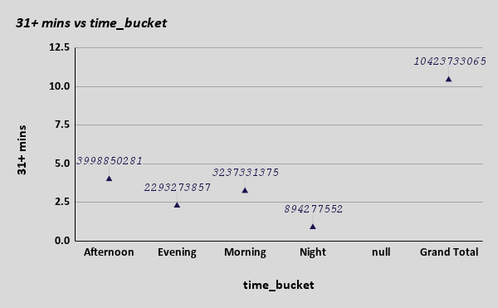
Time-of-Day × Engagement
Evening = highest viewership and longest sessions.
Morning = short bursts, likely casual viewing.
Recommendation: premium ads during Evening + Long sessions.

Slide 15
Recommendations
Focus advertising & flagship shows in Evening slots.
Create youth-targeted content(18-35 = large audience).
Leverage female audience dominance with lifestyle and drama genres.
Double down on top provinces with regional ad partnerships.
Use channel insights to balance programming strategy.

